Slide 1
Build better web apps with Blazor in .NET 10
Daniel Roth
Principal Product Manager
Microsoft
Notes:
Hello everyone! I'm Daniel Roth, Product Manager for ASP.NET Core & Blazor on the .NET team. I'm excited to show you how you can build better web apps with Blazor in .NET 10.

Slide 2







ASP.NET Core Blazor
Modern web UI development with C#
All .NET, from the frontend to the backend
Reusable web UI components
Server and client rendering
Optimized for performance
Built-in security
JavaScript interop
Notes:
Blazor is a web framework for building full-stack web apps with C# and .NET. With Blazor, you can build your entire app, from the frontend to backend, using a single language and framework - no JavaScript required.
At its core, Blazor is about building reusable UI components with C# and HTML. It includes a rich set of built-in components and a large ecosystem of third-party libraries to help you build apps faster.
Blazor offers flexible rendering options: run your components on the server, or on the client with WebAssembly or in a hybrid native app. It's optimized for performance, includes built-in security features, and allows seamless interoperability with JavaScript when needed.

Slide 3

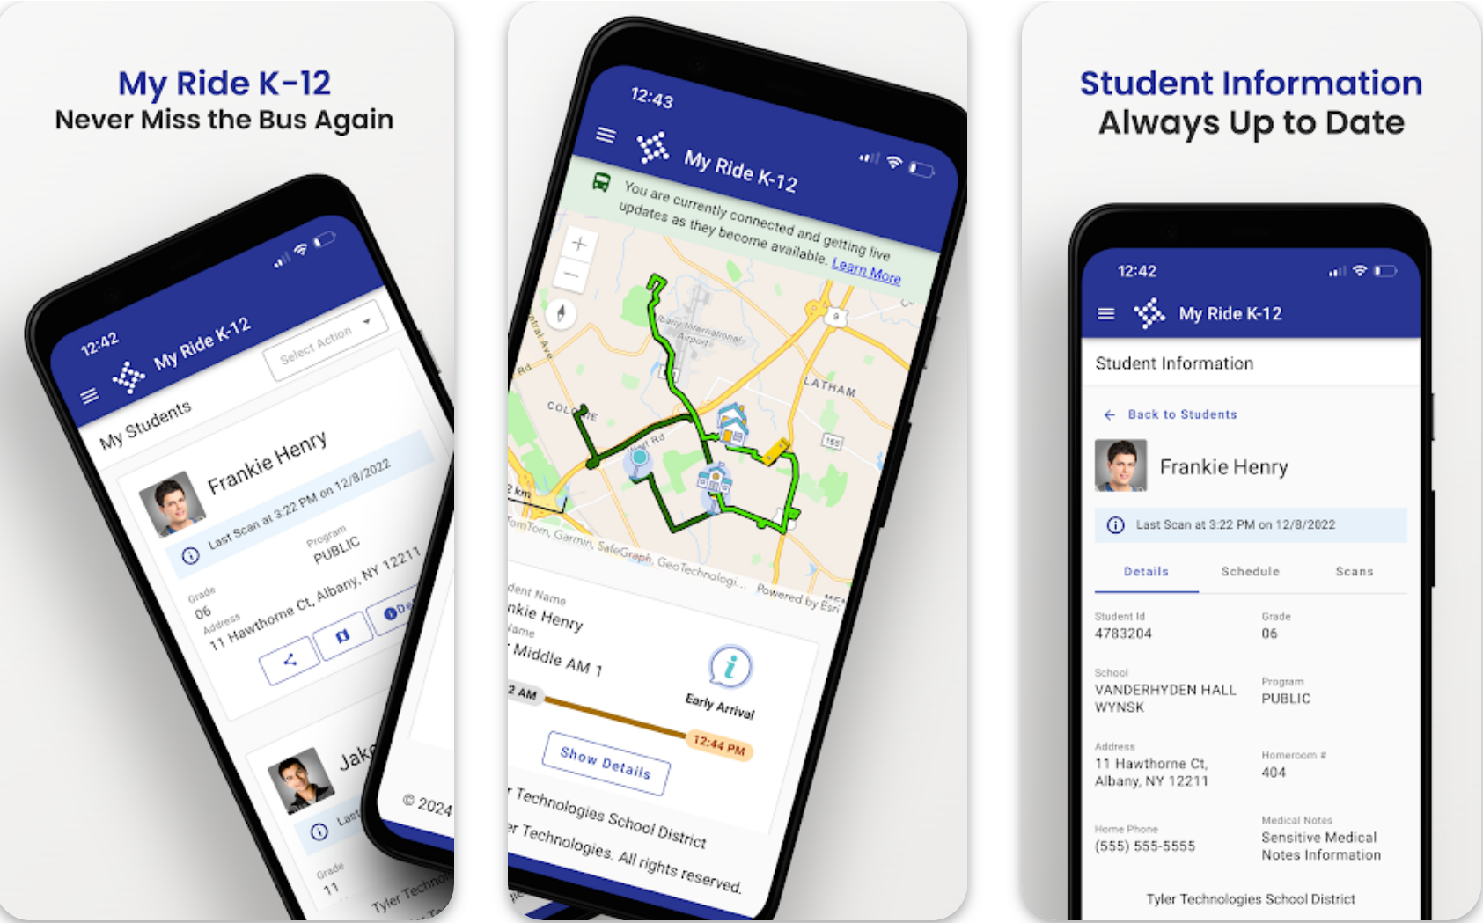

My Ride K-12
.NET MAUI Blazor Hybrid & Web
On day one, we supported web browsers, tablets, and phones. Every update goes to all platforms. For our QA people, it's just one UI to test. They verify that it works correctly on each platform, but it's the same logic and 99% the same UI across the board. The project has been an overwhelming success for us.
Chris Miller, Software Architect, Tyler Technologies, Inc.
2500+
37%
750K
Schools
Nation’s students routed by app
Downloads
https://play.google.com/store/apps/details?id=com.tylertech.myridek12&hl=en_US
https://apps.apple.com/us/app/my-ride-k-12/id6443848115?platform=iphone
Notes:
Blazor is for building web apps both big and small.
The My Ride K-12 app from Tyler Technologies’ is a great example of how Blazor enables developers to be maximally productive. The My Ride app helps parents track student bus routes and transportation schedules. The app is used by over 2500 K-12 schools across US and Canada, and it has over 750k downloads on the Google and Apple app stores.
My Ride uses Blazor to target the web and native devices at the same time. It's built by a small but agile team of engineers with incredible results. When they make a UI update, it's immediately available across platforms, which increases agility and reduces costs.

Slide 4


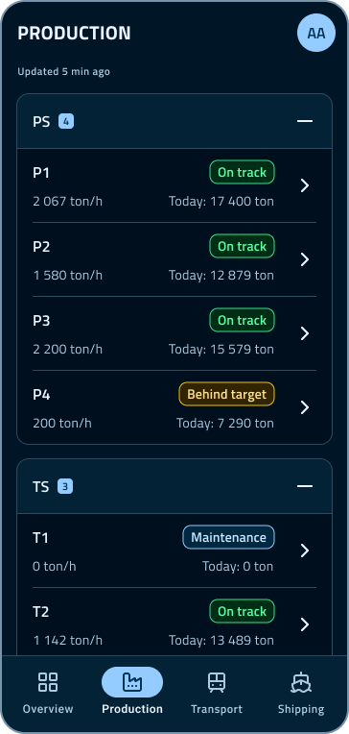
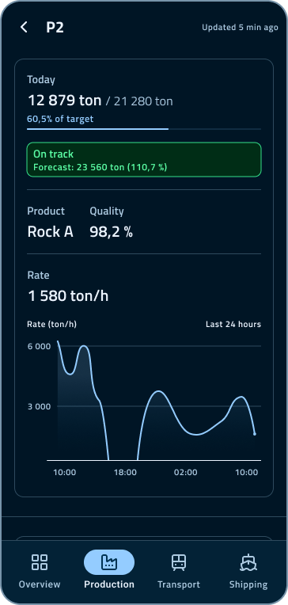
LKAB
.NET MAUI Blazor Hybrid & Web
LKAB mines 80% of all iron ore in the EU. We used to rely on multiple frameworks and external consultants, which made our app ecosystem hard to manage. By standardizing on .NET and Blazor and bringing development in-house, we’ve streamlined our development, reduced maintenance costs, and become far more agile in delivering new features
Patrik Vesterberg, IT Architect & System Developer, LKAB
Notes:
LKAB, Europe’s largest iron ore producer, transformed its mobile strategy by adopting .NET MAUI and Blazor. Previously, apps were built using multiple different frameworks, creating high maintenance costs. Today, a unified Blazor-based approach powers cross-platform apps for iOS, Android, Windows, and soon the web, all from a single codebase. This shift has streamlined development, reduced maintenance overhead, and accelerated delivery of new features, improving productivity across the organization.

Slide 5
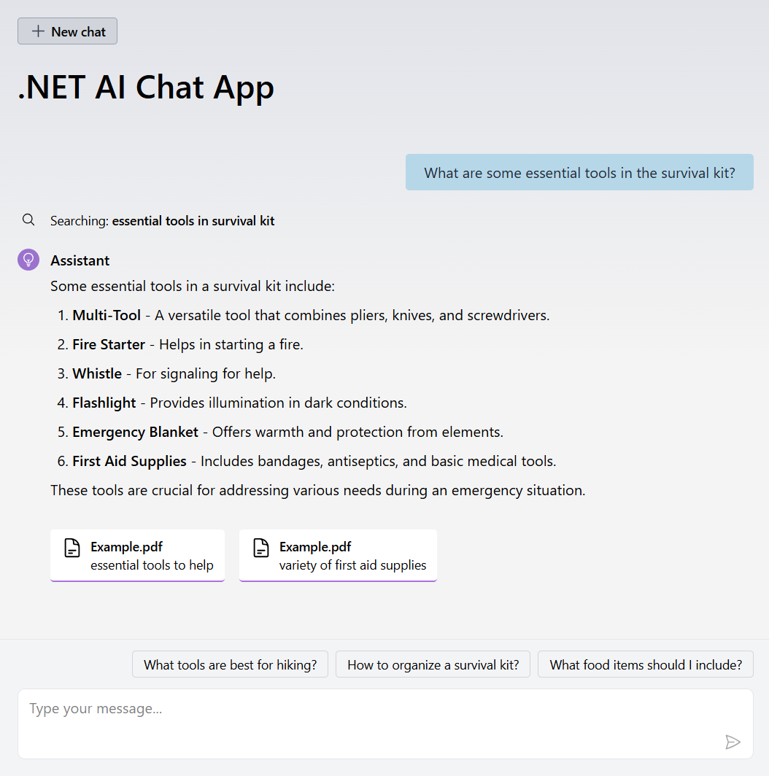
Blazor ❤️’s AI
Build agentic UI with Blazor
Get started with the .NET AI Chat Web App template
Quickstart: aka.ms/dotnet/ai-templates
Built with Blazor!
Streaming responses, markdown rendering, citations, suggested prompts
Flexible AI integration
GitHub Models, Azure OpenAI, OpenAI, Ollama
RAG enabled with multiple vectors stores
SQLite, Azure AI Search, Quadrant
Aspire integration with Gen AI OpenTelemetry✨
Notes:
Blazor is also great for building AI-powered web apps. Blazor's powerful server-side rendering model makes building rich, interactive AI experiences particularly easy.
You can get started using Blazor to build AI powered apps with the .NET AI Chat Web App template. This template is more than just a basic chat app. It shows you how to build Blazor components that handle streaming responses, markdown rendering, citations, and suggested prompts.
The template works with a variety of AI service providers and integrates with various vector stores for retrieval augmented generation (RAG).
The template includes Aspire, so your AI app is cloud-ready and easy to monitor & troubleshoot.
To get started with the .NET AI Chat template, check out the quickstart at aka.ms/dotnet/ai-templates.

Slide 6
Blazor in .NET 10
Build better web apps
Simplified security
Observability & diagnostics
Performance improvements
Delight developers
Notes:
Blazor is now even better in .NET 10, the latest release of the .NET platform. We’re so excited for you to try out this new release!
In .NET 10, we focused on four key areas for ASP.NET Core & Blazor:
- Simplified security. Make it easier to build secure apps
- Better observability & diagnostics
- Improved performance
- Delighting developers by addressing top pain points & feature gaps
Let's look at each of these areas in more detail.

Slide 7
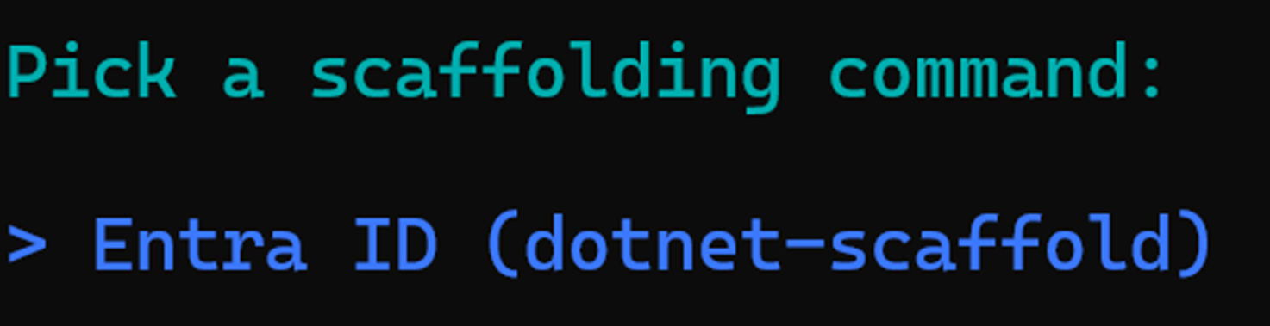
Security simplified
Passkeys & authentication scaffolding
Password-less authentication with WebAuthN & Passkeys
New scaffolder for Entra ID authentication
Notes:
In .NET 10 we want to make it easier to build secure web apps with ASP.NET Core & Blazor.
To do that, we've added built-in support for passwordless authentication using WebAuthN and Passkeys. I'll talk more about that in a moment.
We're also working on new authentication scaffolders to make it easier to add authentication to existing apps. The new Entra ID scaffolder for setting up Entra ID authentication in ASP.NET Core & Blazor apps is now available from the command line using the `dotnet scaffold` tool.

Slide 8
WebAuthN & Passkeys
Goodbye passwords
Blazor templates updated to include Passkeys support
Built on ASP.NET Core Identity
Passkeys are cryptographic credentials that replace traditional passwords.
They are phishing-resistant, easy to use, and secure by design.
How Passkeys work:
A passkey consists of a public-private key pair, scoped to a specific account and origin.
The private key is stored in an Authenticator.
The Authenticator requires user verification before allowing authentication
Notes:
With .NET 10, Passkeys support is now integrated with the Blazor Web App template and supported by ASP.NET Core Identity.
Passkeys are cryptographic credentials that replace traditional passwords. They're phishing-resistant, easy to use, and secure by design.
A passkey consists of a public-private key pair, scoped to a specific account and origin. The private key is stored in an Authenticator. The Authenticator verifies user identity before allowing authentication with a stored passkey.

Slide 9

WebAuthN & Passkeys
Password-less authentication using WebAuthN & Passkeys with ASP.NET Core Identity & Blazor
Notes:
Let me show you how easy it is to get started with passkeys.
- Create a new Blazor Web App with Identity
- Log in with username & password
- Add a passkey and give it a name
- Log out and then log in with the passkey
- Show that we can add additional passkeys that can be saved on a roaming device

Slide 10
Observability & diagnostics
Metrics, traces, and diagnostic tools
New Blazor specific metrics
Improved tracing for Blazor Server
Diagnostic tools for Blazor WebAssembly
Notes:
Next let's look at app observability & diagnostics.
In .NET 10, we’ve made it easier for you to monitor and diagnose issues in your ASP.NET Core & Blazor apps.
We now have lots of Blazor specific metrics, like metrics for page navigations, UI events, active circuits, and more.
We’ve improved tracing for Blazor Server apps, so you can see the activities associated with specific pages and events.
We also added new diagnostic tools for Blazor WebAssembly apps so you can collect performance profiles, memory dumps, and runtime metrics.

Slide 11

Metrics, traces, & diagnostic tools
New Blazor metrics, improved Blazor Service distributed tracing, and Blazor WebAssembly diagnostic tools
Notes:
An easy way to see metrics and traces during development is to use the .NET Aspire.
We can add .NET Aspire to our Blazor app using Visual Studio. Just right-click and select Add .NET Aspire Orchestrator Support. This will setup Aspire for local development and configure our app so Aspire show us all sorts of useful information from it.
In the Aspire developer dashboard, let's browser to our app and generate some traffic.
- Navigate to the Counter page and click the counter
In the metrics tab of the Aspire dashboard, we can see a bunch of new Blazor specific metrics:
**aspnetcore.components.navigation**: Tracks the total number of navigations to a given route or component. Notice that there are filters for each route, so you can see how many times a given page is visited.
**aspnetcore.components.event_handler**: Measures the duration of UI events. This is a histogram metric. Notice again the filters for event types and specific event handlers
**aspnetcore.components.circuit.active**: Tracks the number of active circuits in the Blazor Server app. A circuit represents a user session in a Blazor Server app.
- Create another tab and show the count go up
### Blazor tracing
We've also adding improved tracing for Blazor Server apps.
Tracing helps us understand the chain of activites that happen as part of a particular event.
- Go to the traces tab in the dashboard
- Filter to the Blazor related traces
- Show that the traces are linked to the circuit and the HTTP request once the connection is closed
## Demo: WebAssembly Diagnostics
What about Blazor WebAssembly? We don't yet have way yet to push diagnostic information from Blazor WebAssembly apps to the .NET Aspire dashboard. That's something we're working on. But we do have some new diagnostic tools for Blazor WebAssembly apps.
- Note that you'll need the wasm-tools workload for these demos
- Open BlazorBrowserProfiling and run it
- Browse to Counter and click it a few times
- Open the browser dev tools and start recording perf data
- Click on the Counter a bunch and then stop the recording
- View the Timings tab data
- Open BlazorDiagnostics and run it
- Browse to Counter and click it a few times
- Open the browser dev console and collect diagnostic data:
```javascript
globalThis.getDotnetRuntime(0).collectCpuSamples({durationSeconds: 5});
globalThis.getDotnetRuntime(0).collectMetrics({durationSeconds: 5});
globalThis.getDotnetRuntime(0).collectGcDump();
```
- Load the data in VS. Convert the GC dump using `dotnet gcdump convert`

Slide 12
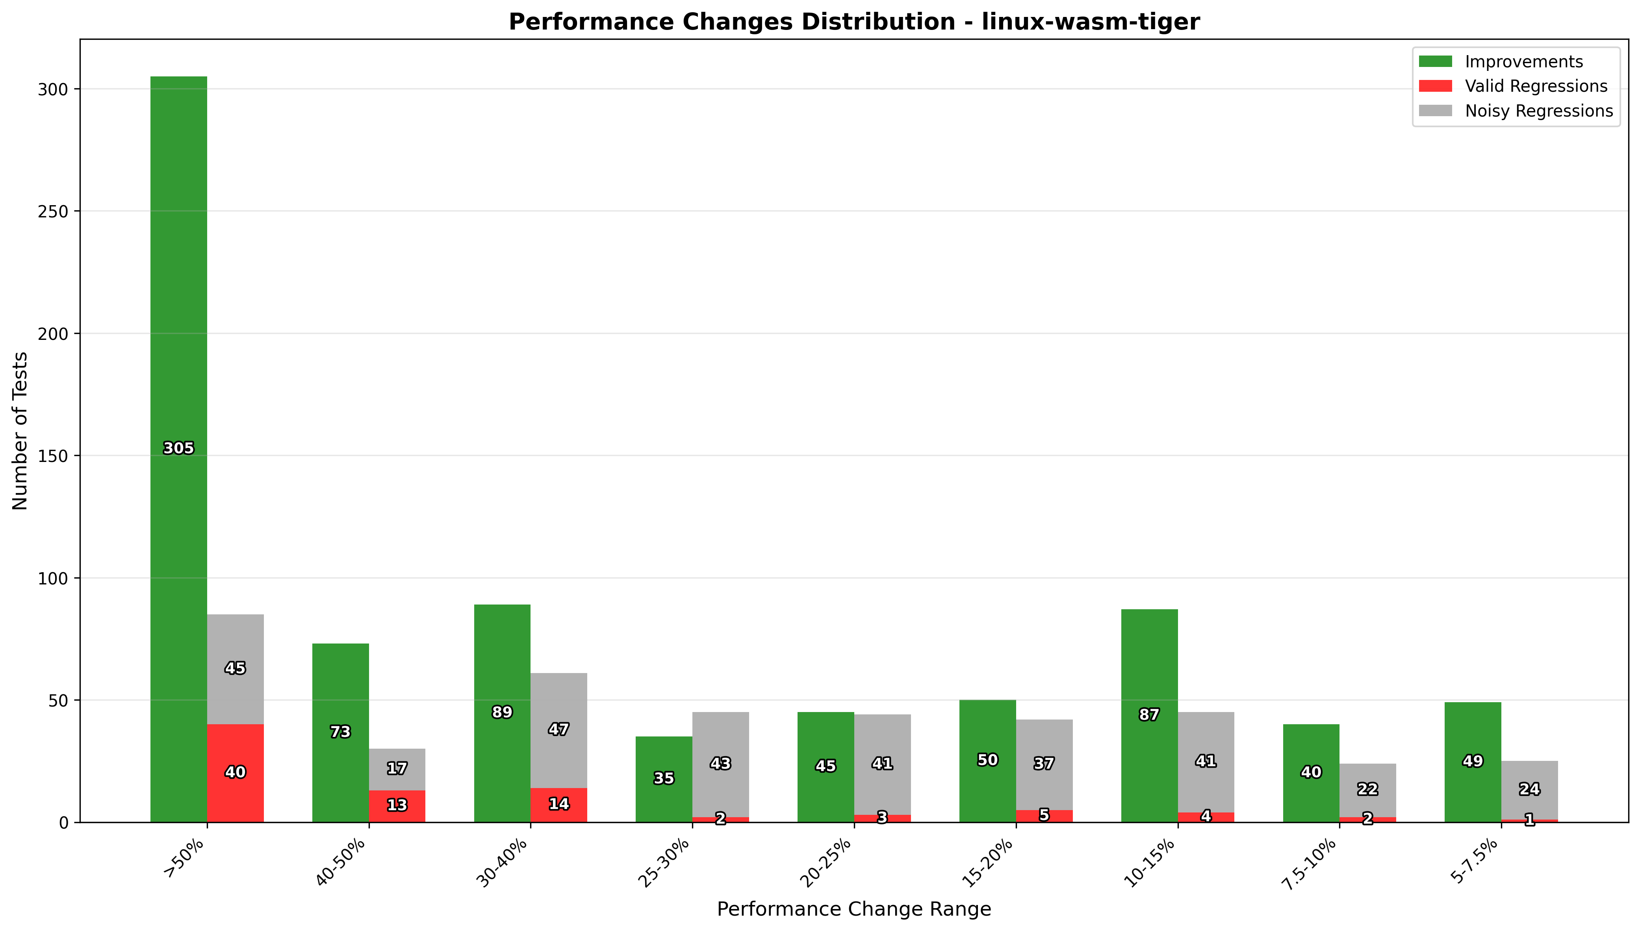
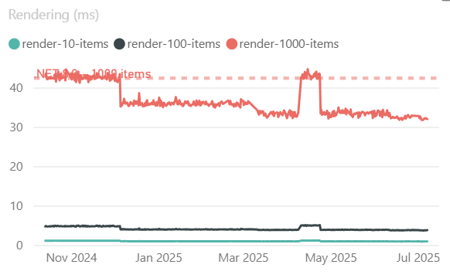
Improved performance
Startup & runtime
Blazor framework scripts fingerprinted, compressed, and cached
Preload Blazor WebAssembly resources
Faster runtime execution & rendering
20% faster rendering!
https://github.com/dotnet/performance/blob/main/reports/net9to10/README.md
https://aka.ms/aspnet/benchmarks
Notes:
Next up, performance.
To ensure that .NET 10 is the fastest release of Blazor yet, we've made a nubmer of optimizations:
- The Blazor framework scripts are now provided fingerprinted, precompressed, and cached, like other static web assets, so they load faster.
- We also preload the Blazor framework files, so you don't have to wait for a cascade of requests before your app loads.
- And we've improved runtime execution performance.
- The chart on your left shows the number of .NET microbenchmarks that showed performance improvements or regressions in .NET 10. Green means improvement, red means regression. The bars to the left count tests that showed great amount of improvement or regression. So, lots of improvement in .NET 10!
- But do these microbenchmark improvements translate to real world performance improvements? Yes! The chart on your right shows our Blazor component rendering benchmark. As you can see .NET 10 is showing 20% faster rendering on WebAssembly compared to .NET 9.

Slide 13

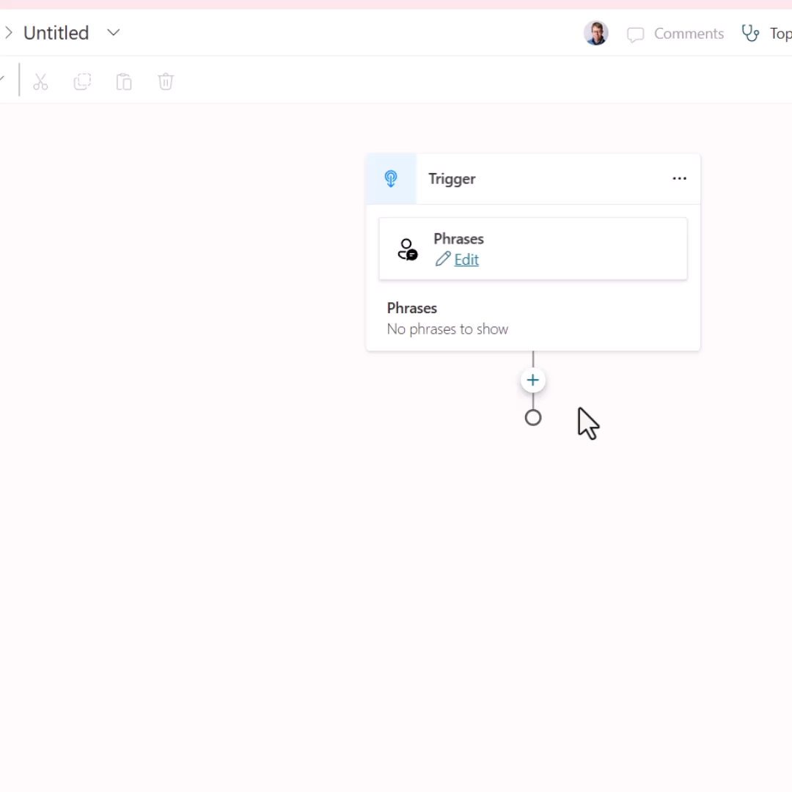
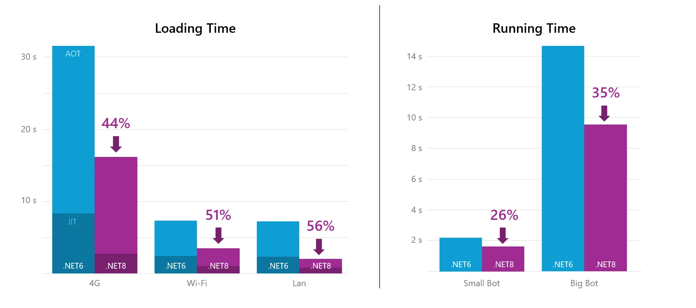
Powering production agents on the web
Microsoft Copilot Studio
Platform for building and managing AI agents and automation.
Maintains a consistent user experience by running existing C# code directly in the browser on WebAssembly.
Leverages .NET WebAssembly ahead-of-time (AOT) compilation for improved runtime performance.
Significant load time & runtime execution performance improvements from the latest .NET version.
https://devblogs.microsoft.com/dotnet/copilot-studio-dotnet-wasm/
Notes:
One of the great things about the .NET platform getting faster is that your app gets faster for free simply by upgrading! This has certainly been true for Microsoft Copilot Studio. Copilot Studio leverages the .NET WebAssembly runtime to run C# code directly in the browser, enabling a consistent experience for AI agent and automation development across their various clients.
When Copilot studio upgraded to the latest .NET 8, they saw significant improvements to be loading time and runtime execution performance. They haven't finished their .NET 10 upgrade yet, but we expect even more performance improvements when they do.

Slide 14

Startup improvements
Optimized framework scripts & preloaded resources.
Notes:
Let's look at the Blazor WebAssembly startup improvements in .NET 10.
- Open BlazorWasmStartup and run it
- Open the browser dev tools networking tab and browse to /counter
- Show that the Blazor framework files are fingerprinted
- Show that a link tag is generated for *dotnet.js* by the new `ResourcePreloader` component
- Show that that *blazor.boot.json* is inlined in *dotnet.js* so it's content is now fingerprinted and it carries the app environment setting as well
- Open BlazorWasmStandaloneStartup and run it
- Show the placeholders in *index.html*:
- `<link rel="preload" id="webassembly" />`
- `<script type="importmap"></script>`
- `<script src="_framework/blazor.webassembly#[.{fingerprint}].js"></script>`
- Explain that the placeholders will get replaced at build time with the correct values
- Show `<OverrideHtmlAssetPlaceholders>true</OverrideHtmlAssetPlaceholders>`
- In the browser dev tools empty the cache and refresh the page
- Show the response index.html file

Slide 15
Delight developers
Address top pain points & feature gaps
Improved Hot Reload
Blazor state persistence
Enhanced form validation
Handle Not Found responses
Consist navigation behavior across render modes
Improve interaction between enhanced nav and scroll position
Add commonly requested features to QuickGrid
JS interop support for invoking constructors, properties, and supplying callbacks
Improve automated browser testing with WebApplicationFactory & Kestrel
Notes:
Lastly, we've done a lot of work in .NET 10 delight developers by addressing top pain points and gaps in Blazor development.
- **Improved Hot Reload**: One top area of feedback is Hot Reload. We've been working closely wtih the Visual Studio to make Hot Reload with Blazor faster and more reliable.
- **State persistence**: We add adding framework support for state persistence to address many of the common pain points with the stateful nature of Blazor Server apps. More on that in a moment.
- **Enhance form validation**: Blazor form validation now supports validating nested models, making it easier to build complex forms.
- **Handle Not Found responses**: We've improved the handling of Not Found responses in Blazor apps.
- **Consistent navigation behavhior**: We made Blazor's navigation behavior more consistent across render modes.
- **QuickGrid improvements**: We've added commonly requested features to QuickGrid, like row classes and the ability to hide column options.
- **JS interop improvements**: We've smoothed out the JavaScript interop story by making it easier to work with JavaScript properties, constructors, and callbacks.
- **Automated browser testing**: We've made it easier to do automated browser testing of Blazor apps with WebApplicationFactory & Kestrel.

Slide 16
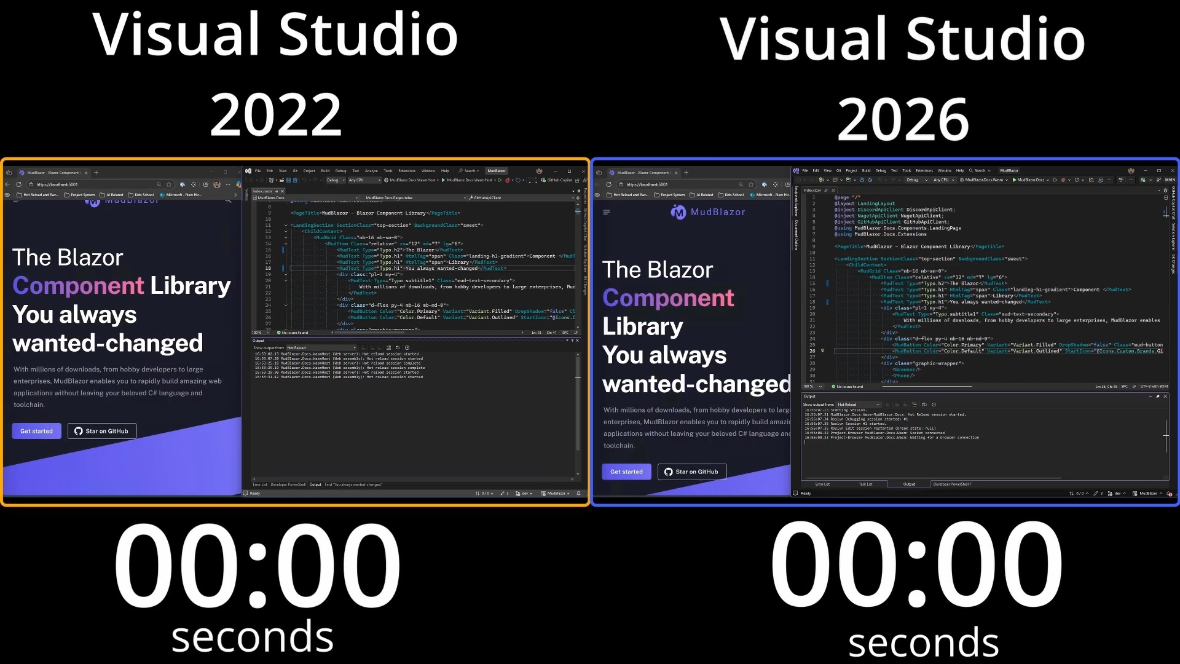
🔥Faster Hot Reload
Notes:
## Faster Reload
Hot Reload is now much faster thanks to improvements in Visual Studio 2026.
The video on the left shows using Hot Reload in Visual Studio 2022 to apply a change to MudBlazor sample app, a popular Blazor open source component library. As you can see, it takes almost 40sec for the change to be applied. Not very hot!
The video on the right shows the same change in Visual Studio 2026 Insiders. It's over 10x faster!
And we're not done! We're continuing to work to make Hot Reload as fast and reliable as possible.

Slide 17
Enhanced form validation
Validate complex forms with nested structure
Notes:
Blazor's form validation support now supports validation nested models. This is based on the same validation support that we introduced for Minimal APIs.
Here I have a complex model type with data annotations on both the root and nested types.
I built a form based on this model using the built-in EditForm component. It uses the built-in `DataAnnotationsValidator` to validate the model. The only additional change I made is to call `AddValidation()` to configure the new validation services.
If I now try to submit the form, both the root and nested properties are validated automatically. As I fill out the form, the validation logic is applied correctly.

Slide 18
Automated browser testing
Build integration tests using WebApplicationFactory and automated browser testing tools like Playwright.
Notes:
What about testing your Blazor apps? Unit tests are great, and you should unit test your components. But sometimes you need a proper integration test to fully exercise a feature.
ASP.NET Core provides a useful WebApplicationFactory type that you can use to send in-memory requests to your app. This is great for testing APIs, but with web apps you often need a real browser to reasonably test a feature.
In .NET 10, WebApplicationFactory now supports starting a real Kestrel server, so you can test your web app with a real browser, like using Playwright or Selenium.
- Open WafDemo
- Show the Blazor WebApplicationFactory
- Show UseKestrel & StartServer
- Run the Playwright test and show that it works

Slide 19
Blazor state persistence
Improved reliability & scalability
Simplified prerendered state persistence
New declarative model for prerendering persistent state ([PersistentState])
Persist circuit state before eviction for improved reliability
Persist circuit state on the server when client is disconnected for extended period
Ex. User switched browser tabs, swiped away from browser app on mobile device, etc.
Persist idle circuits for better scalability
APIs for proactively pausing & resuming circuits
Ex. Circuit is idle, server is restarting, client is no longer visible, etc.
Not automatic - implement app specific policy
Notes:
One of the biggest investments we’re making in Blazor for .NET 10 is support for state persistence, which simplifies prerendering and improves app resiliency and scalability.
- **Simplified prerendered state persistence**: Blazor's new declarative model for persisting component state makes it easier to persist state during prerendering. Just add the new `[PersistentState]` attribute to any property you want to persist and Blazor will take care of the rest.
- **Persist circuit state before eviction**: Blazor Server apps will now automatically persist circuit state before evicting them when a user gets disconnected. A user can get disconnected from a Blazor Server app by doing simple things, like swiping away from the app on a mobile device, or switching browser tabs. If the user later switches back to the app, they may have lost their state! By persisting the circuit state before eviction, it can be held much longer than the in-memory circuit and restored if the user later reconnects, making the app more reliable.
- **Persist idle circuits for better scalability**: New APIs allow for custom policies to pause and resume circuits based on app-specific criteria, like when a circuit is idle or when the browser tab isn't visible. This can help reduce server resource usage and improve the scalability of Blazor Server apps.

Slide 20
State persistence
Declarative state persistence for prerendering and improving reliability & scalability.
Notes:
- Open BlazorPrerendering
- Run the app and show the prerendering flicker issue
- Switch to persistent-component-state branch
- Explain the code
- Switch the main to show the declarative model
- Explain that the circuit state will now also be persisted automatically before a circuit is evicted
- Switch back to the BlazorPasskeys app with Aspire
- Update the app to not retain any circuits
```csharp
.AddInteractiveServerComponents(options => options.DisconnectedCircuitMaxRetained = 0);
```
- Run the app
- Open the browser dev tools
- Browse to Counter and click the counter button a few times
- In the browser dev tools networking tab, throttle the network to be offline
- Wait 15sec for the connection to be dropped
- Turn off network throttling and show the count was lost
- Enable state persistence by adding `[PersistentState]`
```csharp
[PersistentState]
public int CurrentCount { get; set; }
```
- Show that the count is now persisted and restored
- Explain that the state is persisted in memory by default, but also supports `HybridCache`
- We can also programmatically pause circuits to reduce server load
- Reopen BlazorIdentity and add code to pause when the browser isn't visible
```html
<script>
document.addEventListener('visibilitychange', () => {
if (document.hidden) {
Blazor.pauseCircuit();
} else {
Blazor.resumeCircuit();
}
});
</script>
```
- Show that circuits come and go as the browser visibility changes, but the counts are preserved

Slide 21
Blazor in .NET 10
Get started today!
blazor.net
Build better web apps
Simplified security
Observability & diagnostics
Performance improvements
Delight developers
WebAuthN & Passkeys
Entra ID scaffolder
New metrics
Improved tracing
Blazor WebAssembly diagnostic tools
Optimized framework scripts
Runtime resources preloaded
Faster runtime execution & rendering
State persistence
Hot Reload improvements
Enhanced form validation
Improved navigation & Not Found handling
QuickGrid & JavaScript interop enhancements
Automated browser testing
Notes:
Here's a summary of what's new in Blazor in .NET 10. Blazor in .NET 10 is loaded with significant advancements in security, observability, performance, and developer experience. You can get started today with Blazor in .NET 10 by going to blazor.net. We're excited to see what you’ll build with these new features and improvements!

Slide 22
Thank you

